Slide 1
SOFTWARE INNOVATION STUDIO
ClaimTrace — the academic citation audit engine
Market & Competitor Analysis
Group 18 · Sichen Liu · Hongyang Chen · Siyuan Sun · Jun Li · Yi Jiang · Zheng Fu · Yiyang Yuan

Slide 2
The targeted market
MARKET FOUNDATION & CORE GAP
1
The targeted market
2
How large, and the trend
Academic writing:
Overleaf reports 20M+ users; 5.7M papers published in 2024 (+46% from 3.9M in 2019). Every claim cites a source.
Fragmented commercial sizing:
Tooling market sized 3× apart by vendors ($371M–$1,150M for the same year).
Single audited benchmark:
Clarivate Academia & Govt segment (Web of Science + EndNote) is $1,266.0M FY2025 (SEC Form 10-K).
Citation integrity crisis:
16.9% of quotations incorrect, 8.0% major errors across 46 studies (32,074 quotations, no improvement in 40 years).
→ Quote report scope & CAGR, or cite audited SEC filings.
3
What already exists
4
The gap
Reference managers: Zotero (14.4M users), Mendeley,
EndNote (format metadata).
Zero claim validation: No tool checks: “Does my cited source support my sentence?” ReciteWorks FAQ: “No, not currently”. $175 buys metadata, $125 buys similarity.
Similarity checkers: Turnitin, iThenticate
(match text; not plagiarism).
Reference checkers: ReciteWorks, Edifix,
CiteTrue (confirm record exists).
Rapidly escalating severity: Fabricated citations grew 12-fold from 1 in 2,828 (2023) to 1 in 277 (early 2026); 98.4% of affected papers had no publisher action.
Citation intent: scite (1.6B Smart Citations), Semantic Scholar (classify third-party citations).
Sources: Overleaf (20M+ users); Dimensions/STM Report (5.7M papers 2024); Baethge & Jergas (2025) Res Integr Peer Rev (16.9% err, p=0.85); SEC Form 10-K Clarivate FY2025 ($1,266.0M); Zotero Annual Report 2024 (14.4M); Lancet/Nature 2026 PMC Audit (12× phantom citation growth).
Notes:
① What is the market?
Our market is academic writing. Overleaf reports more than 20 million users, and 5.7 million papers were published in 2024, 46 percent more than in 2019. All of this work depends on reliable citations. ② How serious is the problem?
Citation errors are common. A 2025 review by Baethge and Jergas covered 46 studies and more than 32,000 quotations. It found that 16.9 percent were inaccurate, including 8 percent with major errors, where the source means something different from the author’s claim. The review found no clear improvement over 40 years. ④ Market size and the gap
The market is difficult to size precisely. Three commercial estimates for the same year range from $371 million to $1.15 billion, almost three times apart. Clarivate reported $1.266 billion in audited revenue for its broader Academia and Government segment. We show that figure with its scope, rather than present it as the size of our specific market.
Existing tools address related tasks. Reference managers organise citations. Turnitin checks text similarity. Reference checkers confirm that a record exists, while scite shows how other papers cite a source. But these established tools do not directly answer our question: Does my source support my sentence? ReciteWorks says it does not currently offer that check. That is the gap ClaimTrace aims to fill.

Slide 3
The targeted market — Empirical Evidence
SURFACE RATIO · MARKET VARIANCE · GAP MATRIX
User Disparity
Market Divergence
Paper Volume (+46%) vs Tooling Sizing (3× Vendor Spread)
Writing Surface vs. Paying Surface
GlobalInfo $371M 2024 vendor
YH Research $385M 2024 vendor
WiseGuy $1,150M 2024 vendor
Clarivate A&G (SEC 10-K) $1,266.0M Audited FY2025
The mass writing citations vs. the niche currently paying.
Figure 3 · Capability Matrix
Overleaf Citation Writers
20,000,000+
Tool Class & Representative | 1. Record Exists? | 2. Text Match? | 3. Cited by Others? | 4. Source Supports MY Claim?
Reference Managers (Zotero, EndNote) | Yes | No | No | No
Similarity Tools (Turnitin, iThenticate) | No | Yes | No | No
Citation Intent (scite.ai, Sem. Scholar) | Yes | No | Yes | No
ClaimTrace (Audit Engine) | Yes | Yes | (Fallback) | ★ SOLE FOCUS
scite.ai Paying Subscribers
~21,000
~950 : 1
Writing surface to monetised validation ratio
Sources: Surface: Overleaf about page (20M+ users) vs scite acquisition disclosures (~21k subscribers, 950:1); Market: Dimensions STM (3.9M→5.7M, +46%), Clarivate 10-K FY25 ($1,266.0M); Matrix: 13 vendor documentation audits.

Slide 4
Case Study
PRIMARY COMPETITOR ANALYSIS
scite.ai — the biggest competitor, and the one every reviewer names first
What it is
Why it is the case to study
Origin & Leadership: Founded 2018 in Brooklyn;
co-founder & CEO Josh Nicholson.
Comparable Engineering Pipeline: Only competitor with full-text ingestion, a trained deep classifier, and published methods.
Core Mechanism: Smart Citations label how a paper has been cited — supporting, contrasting, or mentioning — one label per citation statement.
Proven Commercial Category: Demonstrates the willingness to pay — acquired by a NASDAQ-listed strategic buyer.
Indexed Scale: 1.6B+ Smart Citations, 317M+ articles indexed, 44+ publisher partners.
Transparent Peer-Reviewed Accuracy: Its published papers document precision, recall, and known architectural weaknesses.
Acquisition Event: Acquired by Research Solutions (NASDAQ: RSSS) announced 27 Nov 2023, closed 1 Dec 2023.
Fundamentally Different Question: Answers an entirely distinct question from ClaimTrace, stated explicitly on its own product page.
Financial Baseline: ~21,000 paying subscribers, $3.6M annualised subscription revenue, $1.1M FY2023 revenue at acquisition.
Takeaway: The category is real and funded. But the market leader answers “how have others cited this paper?” — never “does my sentence match my source?”
Sources: scite.ai/features (2026-09-24 audit); Research Solutions (Nasdaq: RSSS) Form 10-K & Press Releases (Initial consideration: $21.1M, earn-out: $15.4M settled Jul 2025, ~ $29M all-in; $20.9M net of cash acquired).

Slide 5
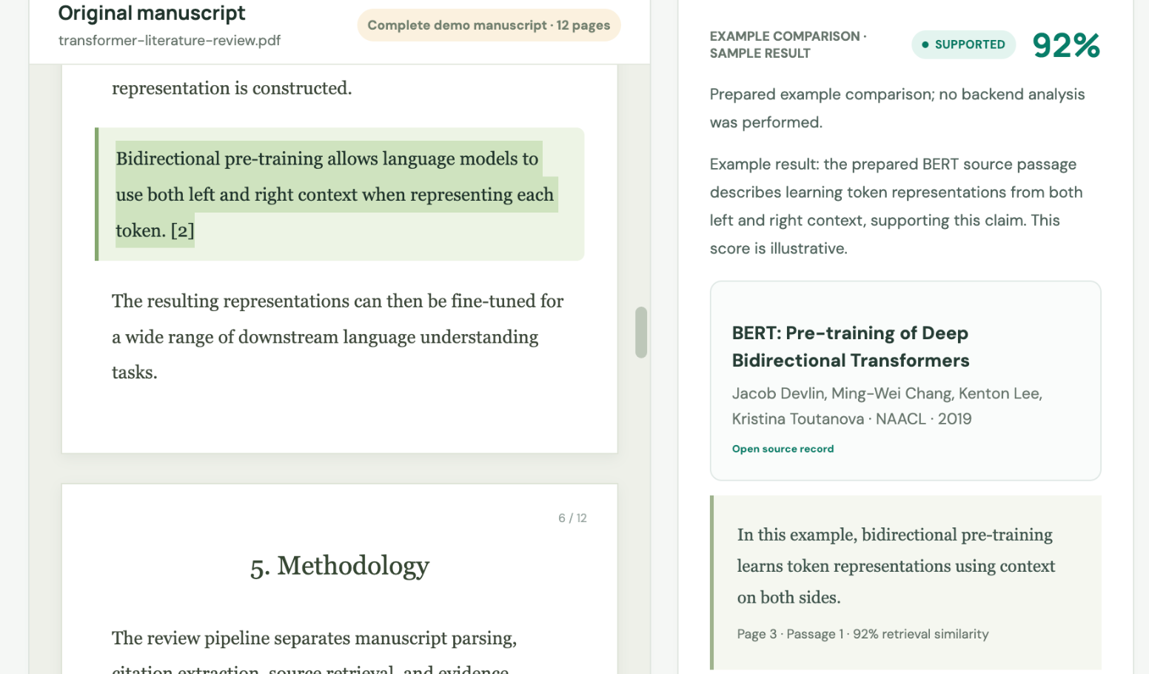
Core Function One
SMART CITATIONS AT SCALE
Smart Citations — classify how a paper has been cited, at scale
Empathise
Define
Ideate
A researcher asks: can I trust this paper? Reading all citing papers is impossible; raw citation count hides disagreement.
Classify each citation statement as supporting, contrasting, or mentioning. Must rest on scientific evidence, not sentiment.
Fine-tune SciBERT over 38,925 labelled statements (9,708 holdout; ~2 yrs annotation). Production target: >80% precision.
What its own paper measures (Nicholson et al., 2021)
Initial F-score: 96.3 mentioning · 55.3 supporting · 20.5 disputing
Disputing improved to 58.97 F-score (85.19 precision)
Distribution: 92.6% mentioning · 6.5% supporting · 0.8% disputing
Ingestion fails on ~30% of citation statements/references in PDFs
Our comment: The engineering is serious, but failure mode is a label reading as reassurance (0 contrasting vs 17 seen by humans). Aggregate labels about a paper cannot answer for your sentence. ClaimTrace's response: verdicts only on states actually judged; all others stay explicitly unjudged.
Sources: Nicholson et al. (2021) Quant Sci Stud 2(3):882–898; Bakker, Theis-Mahon & Brown (2023) Hypothesis 35(2) doi:10.18060/26528 (scite authors published reply in 2025).

Slide 6
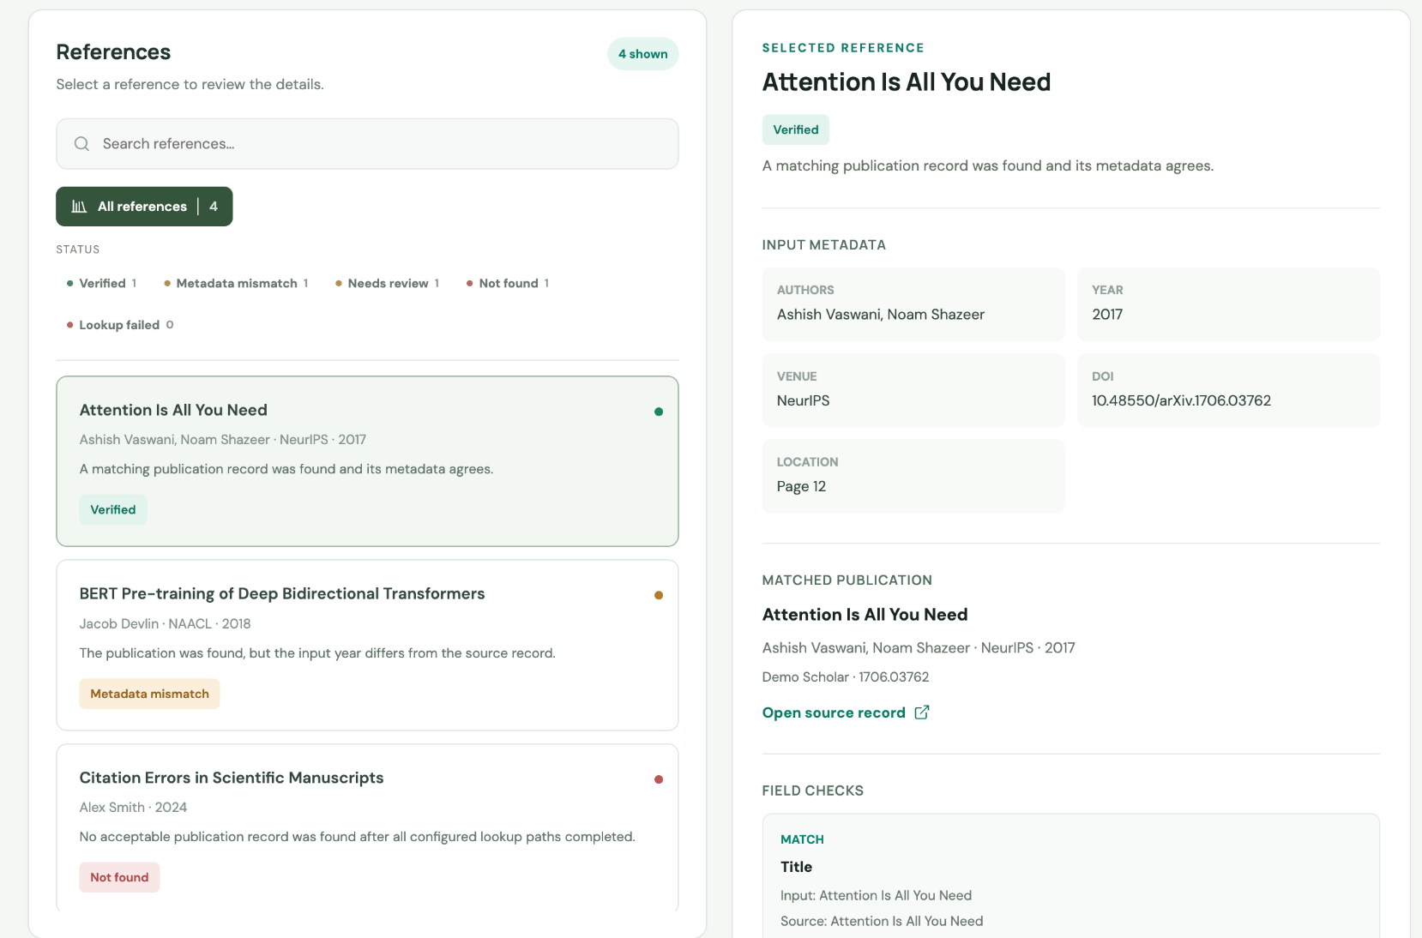
Core Function Two
MANUSCRIPT PRE-SUBMISSION AUDIT
Reference Check — point the same corpus at your own manuscript
Empathise
Define
Ideate
Pre-submission fear: references inherited from co-authors, Scholar, or AI. Fear that an entry is retracted or wrong.
Upload PDF to inspect third-party history per reference: retractions, editorial notices, and contrasting findings.
Repurpose corpus as a submission checklist per reference rather than per paper, bundled inside the core SaaS subscription.
Our comment — where this stops
Reports on third parties: Tells you #12 is retracted; cannot tell you if your sentence about #12 is accurate.
Metadata, not meaning: Notices are facts about a record. Silent on whether it supports the claim attached.
No published accuracy: Smart Citations has peer-reviewed evaluations; Reference Check publishes none.
User-level SaaS pricing: $20/mo Basic, $50/mo Pro (billed yearly); no public institutional pricing.
Sources: scite.ai/features & scite.ai/pricing ($20/$50/mo); ClaimTrace audit contract specification docs (claimtrace/docs/audit-contract.md §2, §4).

Slide 7
Thank you
ClaimTrace — the academic citation audit engine
Software Innovation Studio · Group 18

